Slide 1
OPERATING SYSTEMS
INTRODUCTION

Slide 2
Objectives of OS
An operating system can be thought of as having three objectives or as performing three functions.
Convenience - An operating system makes a computer more convenient to use.
Efficiency - An operating system allows the computer system resources to be used in an efficient manner.
Ability to evolve - An operating system should be constructed in such a way as to permit the effective development, testing and introduction of new system functions without interfering with current services provided.

Slide 3
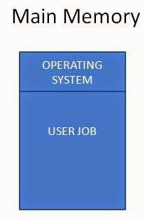
Uni-programming
Uni-programming is a term used for those computers which can have only a single task/job in the main memory at a time.
Any job/task which has to be executed/run by the CPU must be present in the main memory and if a computer can have only a single task in the main memory at a time then it is known as Uni-Programming.

Slide 11
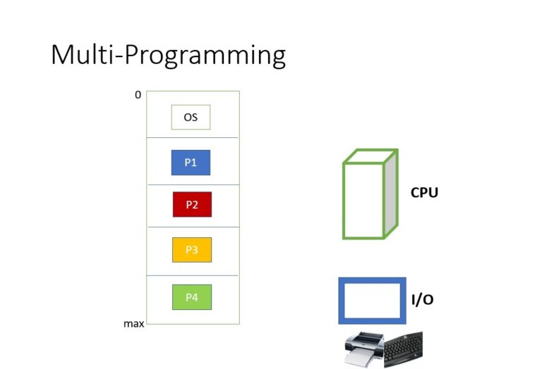
Multi-Programming
In multi-programming more than one process can reside in the main memory at a time.
Thus, when process P1 goes for I/O operation the CPU is not kept waiting and is allocated to some another process (lets say P2).
This keeps the CPU busy at all times.

Slide 20
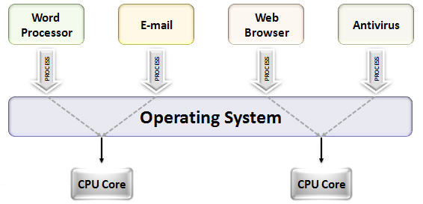
Multi-tasking
Multitasking is the process of performing multiple tasks at the same time.
For example, multiple applications execute in a computer simultaneously.
Browser, word application, calculator, etc. can execute at the same time.

Slide 21
Multi-tasking
Even though most modern computers support multitasking, the system can execute a specific number of tasks at a time.
It is because when there are multiple tasks, each task requires more resources.
Thus, this can cause a decrease in system performance.
Therefore, an adequate number of tasks executes at a time.
Overall, multitasking helps to improve the productivity of the system.
Multi-tasking system uses multi-programming.

Slide 22
Time-sharing
Time sharing is a method that allows multiple users to share resources at the same time.
Multiple users in various locations can use a specific computer system at a time.
Several terminals are attached to a single dedicated server with its own process.
Therefore, the processor executes multiple user programs simultaneously.
In other words, the processor time is shared between multiple users at a time.
The processor allows each user program to execute for a small time quantum.
Moreover, time sharing systems use multiprogramming and multitasking.

Slide 23
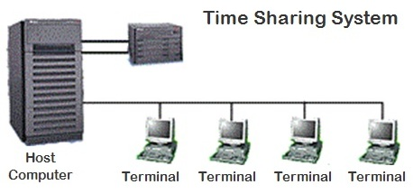
Time-sharing vs Multi-tasking
Time sharing is the sharing of a computing resource among many users by means of multiprogramming and multitasking at the same time whereas multitasking is the concurrent execution of multiple tasks or processes over a certain period of time.

Slide 24
Multi-processing
In a uni-processor system, only one process executes at a time.
Multiprocessing is the use of two or more CPUs (processors) within a single Computer system.
The term also refers to the ability of a system to support more than one processor within a single computer system.
Now since there are multiple processors available, multiple processes can be executed at a time.
These multi processors share the computer bus, sometimes the clock, memory and peripheral devices also.

Slide 25
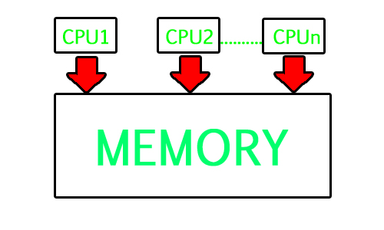
Multi-processing
Multiprocessing refers to the hardware (i.e., the CPU units) rather than the software (i.e., running processes).
If the underlying hardware provides more than one processor then that is multiprocessing.
It is the ability of the system to leverage multiple processors’ computing power.

Slide 26
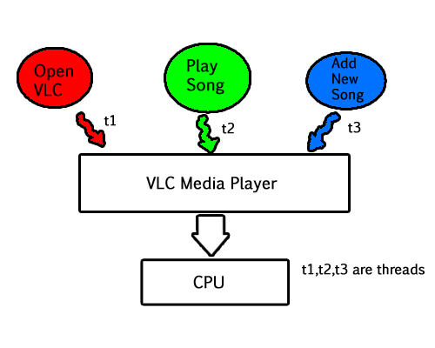
Multi-threading
A thread is a basic unit of CPU utilization.
Multi threading is an execution model that allows a single process to have multiple code segments (i.e., threads) running concurrently within the “context” of that process.
e.g. VLC media player, where one thread is used for opening the VLC media player, one thread for playing a particular song and another thread for adding new songs to the playlist.

Slide 27
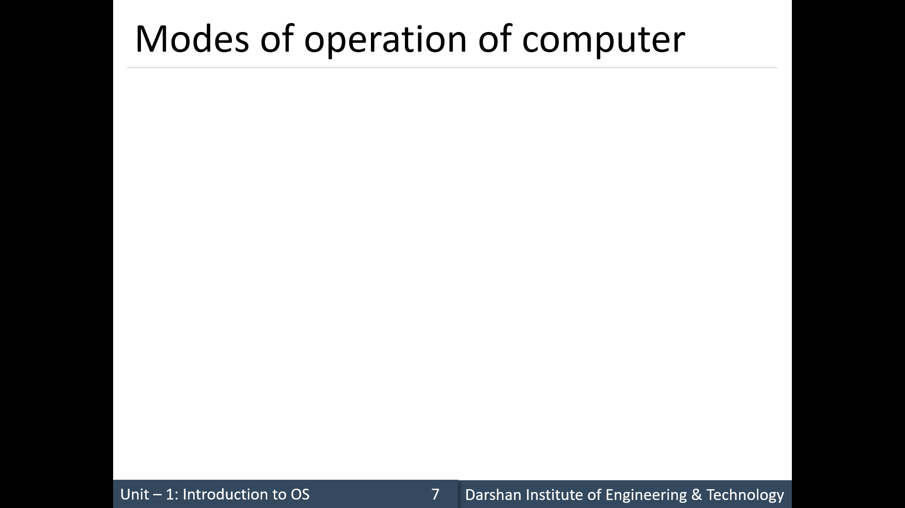

Slide 28
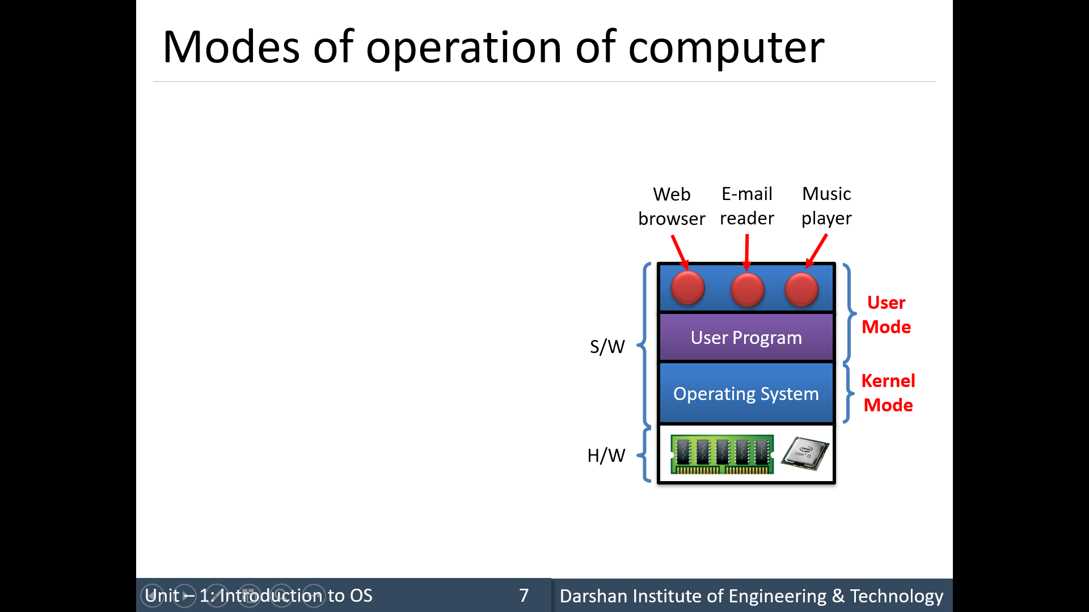

Slide 29
Dual mode operation
In order to ensure the proper execution of the operating system, we must be able to distinguish between the execution of operating-system code and user defined code.
At the very least, we need two separate modes of operation:
user mode and kernel mode (also called supervisor mode, system mode, or privileged mode).
A bit, called the mode bit, is added to the hardware of the computer to indicate the current mode: kernel (0) or user (1).
Increasingly CPUs support multi-mode operations
i.e. virtual machine manager (VMM) mode for guest VMs

Slide 30
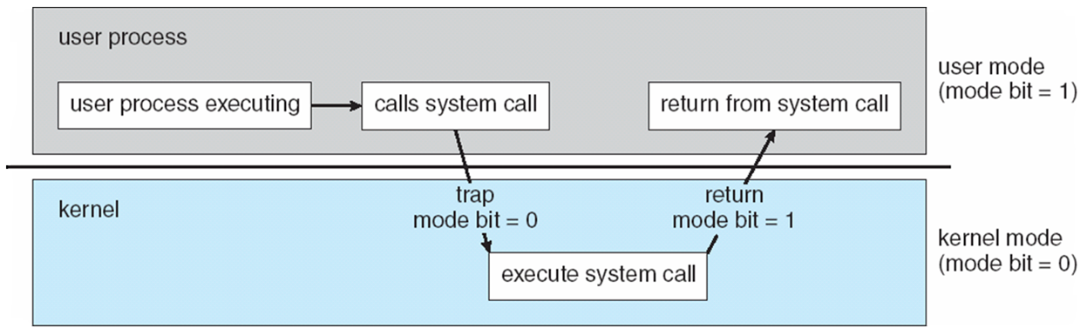
Dual mode operation
When the computer system is executing on behalf of a user application, the system is in user mode.
However, when a user application requests a service from the operating system (via a system call), the system must transition from user to kernel mode to fulfill the request.
Transition from user to kernel mode

Slide 31
Dual mode operation
At system boot time, the hardware starts in kernel mode.
The operating system is then loaded and starts user applications in user mode.
Whenever a trap or interrupt occurs, the hardware switches from user mode to kernel mode (that is, changes the state of the mode bit to 0).
Thus, whenever the operating system gains control of the computer, it is in kernel mode.
The system always switches to user mode (by setting the mode bit to 1) before passing control to a user program.

Slide 32
Dual mode operation
The dual mode of operation provides us with the means for protecting the operating system from errant users—and errant users from one another.
We accomplish this protection by designating some of the machine instructions that may cause harm as privileged instructions.
The hardware allows privileged instructions to be executed only in kernel mode.
If an attempt is made to execute a privileged instruction in user mode, the hardware does not execute the instruction but rather treats it as illegal and traps it to the operating system.
A trap (or an exception) is a software-generated interrupt caused either by an error (for example, division by zero or invalid memory access) or by a specific request from a user program that an operating-system service be performed.

Slide 33
System Calls
System calls provide the means for a user program to ask the operating system to perform tasks reserved for the operating system on the user program’s behalf.
A system call is invoked in a variety of ways, depending on the functionality provided by the underlying processor, like a trap to a specific location in the interrupt vector.
In all forms, it is the method used by a process to request action by the operating system.
The system-call service routine is a part of the operating system.
These calls are generally available as functions written in C and C++, although certain low-level tasks (for example, tasks where hardware must be accessed directly) may have to be written using assembly-language instructions.

Slide 34
System Calls
When a system call is executed, it is typically treated by the hardware as a software interrupt.
Control passes through the interrupt vector to a service routine in the operating system, and the mode bit is set to kernel mode.
The kernel examines the interrupting instruction to determine what system call has occurred; a parameter indicates what type of service the user program is requesting.
Additional information needed for the request may be passed in registers, on the stack, or in memory (with pointers to the memory locations passed in registers).
The kernel verifies that the parameters are correct and legal, executes the request, and returns control to the instruction following the system call.

Slide 35
System Calls
The handling of a user application invoking the open() system call.

Slide 36
Types of System Calls
System calls can be grouped roughly into six major categories:
process control
file management
device management
information maintenance
communications
protection

Slide 37
Types of System Calls

Slide 38
Some examples of System Calls

Slide 39
C Library

Slide 40
API for System Calls
Typically, application developers design programs according to an application programming interface (API).
The API specifies a set of functions that are available to an application programmer, including the parameters that are passed to each function and the return values the programmer can expect.
A programmer accesses an API via a library of code provided by the operating system and is called libc (in case of Linux and Unix).
Why would an application programmer prefer programming according to an API rather than invoking actual system calls?
One benefit concerns program portability.
An application programmer designing a program using an API can expect her program to compile and run on any system that supports the same API

Slide 41
System Boot
The procedure of starting a computer by loading the kernel is known as booting the system.
On most computer systems, a small piece of code known as the bootstrap program or bootstrap loader locates the kernel, loads it into main memory, and starts its execution.
When a CPU is powered up or rebooted—the instruction register is loaded with a predefined memory location, and execution starts there.
At that location is the initial bootstrap program.
This program is in the form of read-only memory (ROM), because the RAM is in an unknown state at system startup.
ROM is convenient because it needs no initialization and cannot easily be infected by a computer virus

Slide 42
System Boot
The bootstrap program can perform a variety of tasks.
Usually, one task is to run diagnostics to determine the state of the machine.
If the diagnostics pass, the program can continue with the booting steps.
It can also initialize all aspects of the system, from CPU registers to device controllers and the contents of main memory.
Sooner or later, it starts the operating system.
A problem with this approach is that changing the bootstrap code requires changing the ROM hardware chips.
Some systems resolve this problem by using erasable programmable read-only memory (EPROM), which is read-only except when explicitly given a command to become writable.

Slide 43
System Boot
For large operating systems (including most general-purpose operating systems like Windows, Mac OS X, and UNIX) or for systems that change frequently, the bootstrap loader is stored in firmware, and the operating system is on disk.
In this case, the bootstrap runs diagnostics and has a bit of code that can read a single block at a fixed location (say block zero) from disk into memory and execute the code from that boot block.
The program stored in the boot block may be sophisticated enough to load the entire operating system into memory and begin its execution.
GRUB (Grand Unified Boot Loader) is an example of an open-source bootstrap program for Linux systems. It also allows user to chose the OS to be booted, in case more than one OS available in the system.

Slide 44
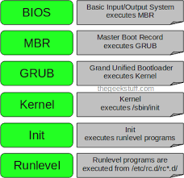
Linux Boot Process

